Slide 1
Matching School Needs and Partner Resources
Administrator Introductory Training

Slide 2
EZPartner In Context
Community Portal Platform
Partner Management System
Volunteer Management System
Contact Management System
(Optional w/ EZPartner)
(Included w/ EZPartner)
Background Checks
Notify About School Events
Campus Sign-In
Report Hours By Partner
Partner Newsletter
EZPartner docs library
Event calendar & FAQs
Survey feedback & forms

Slide 3
Connect Business With Your Schools
Community Partner
Offers
School Staff
Partners apply and then register with the district
Partners appear on the directory listing
Partners can create offers and respond to requests
Employees can register and connect with their employer
Requests
Staff register and select their school
Staff sign-in and create requests
Staff record outcomes of their requests
Staff search for partner offers

Slide 4
EZPartner users
School Staff
* Register individually
* Affiliate w. their school
* Post needs/requests
* Reply to offers/resources
Community Organizations & Employees
* Register individually
* Affiliate w. their partner profile
* Post offers/resources
* Reply to needs/requests
District EZPartner Administrators
* Recruit & register community organizations
* Administer Partner Directory & Profiles
* Facilitate w. communications & reporting

Slide 5
Browser Compatibility
End Users
IE 9 or 10
Chrome
Firefox
Safari
Admin Users
IE 10
Firefox
Chrome

Slide 6
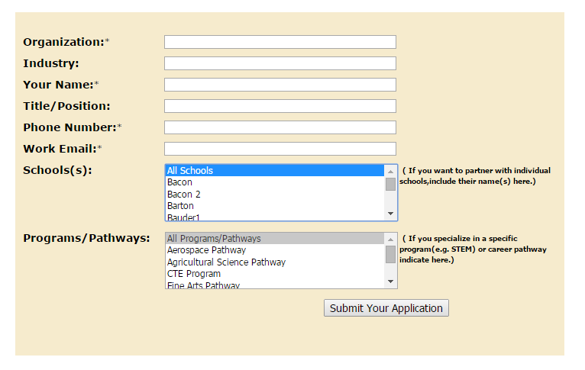
How Partners Get Started
Submit partner business for review
Receive verification e-mail to start registering business
Company logo
Corporate description
Profile manager
After profile verification by staff send activation e-mail
Post offers/respond to requests

Slide 7
Tips For Registering Partners
You can require an Initial Application or go directly to Registration
New Partners must have a ‘Profile Manager’
Name & Display Name can be the same
Logo upload must be LT 100kb and JPG, GIF or PNG
Profile Manager Username = Email Address

Slide 8
Partners, Users, & Relationships
All Partners, Employees, Staff, Admin start with a User record
All Partners, Employees, Staff have one or more School Relationship on their User record
Each Partner Contact is assigned an EZP-Partner Contact relationship w/ the central office and schools on their Partner Profile

Slide 9
Partner Status
Pending = Registered & awaiting activation
Active = Profile on Directory & account access
Deleted = Remains in DB, but not displayed on lists

Slide 10
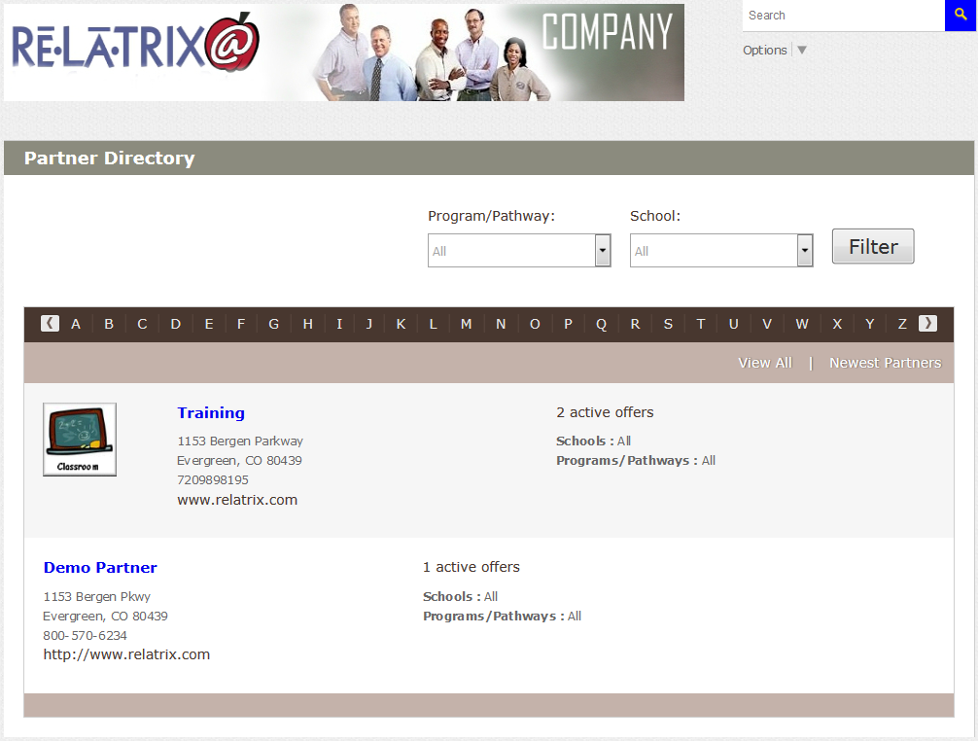
Once A Partner Registers
New partners displayed on front page of directory
Browse by business name
Filter by School or Program
Track active offers from business & employees

Slide 11
Tips For Administering Partners
Go To Admin > Partner Mgt > Partners
Update/add details to Partner Profile
Assign to Schools or Programs
Replacement Partner Contact must have an existing User record (Create an employee record and then assign as Partner Contact)

Slide 12
Sign Up Partner Employees
Register employees after establishing a directory of partners
Associate employees with their business employer for browsing and tracking
Activate account to post offers and contact school staff posting requests

Slide 13
Tips For Signing Up Employees
Employees either select an Active Partner or sign up as UNAFFILIATED
Employees receive activation email or it is sent to EZPartner Administrator
Once activated employees can create offers and respond to requests

Slide 14
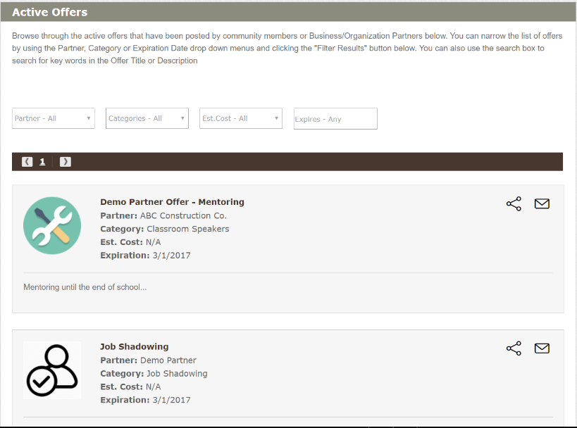
Offer Resources To Schools
Filter offers by partner, category or expiration
Create new offers as a
business or employee
Contact offeror, email a friend, or share on social media

Slide 15
Tips For Administering Offers
Go To Admin > Partner Mgt > Offers
Filter by partner, type or date
Extend, Close or Delete offers
Record outcomes
From Action list Send Notice to Offer Contacts

Slide 16
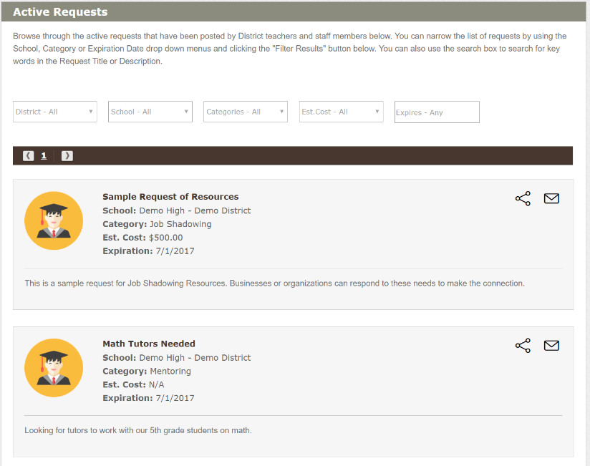
Respond To School Requests
School staff create requests
Filter request list by school
category or expiration
Contact teacher or admin to offer assistance

Slide 17
Tips For Administering Requests
Go To Admin > Partner Mgt > Requests
Category Coordinators can be notified of new requests
Filter requests by school, type or date
Send expiration or close reminders
Record Outcomes and Close requests
From Action list Send Notice to request contacts

Slide 18
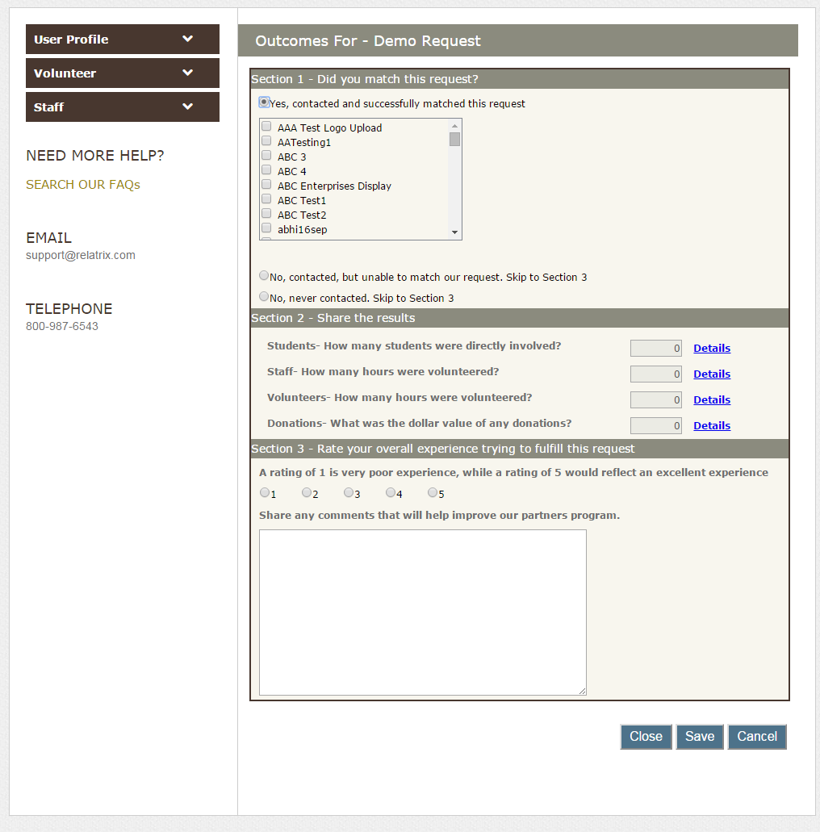
Record Outcomes
Track successful completion of activity for offers or requests
Gather quantitative feedback on students, staff, hours and donations
Include qualitative feedback

Slide 19
Tips For Recording Outcomes
Match one or multiple partners/schools
Record Students involved, Staff development, plus Volunteer and Donations made
Save results or Close

Slide 20
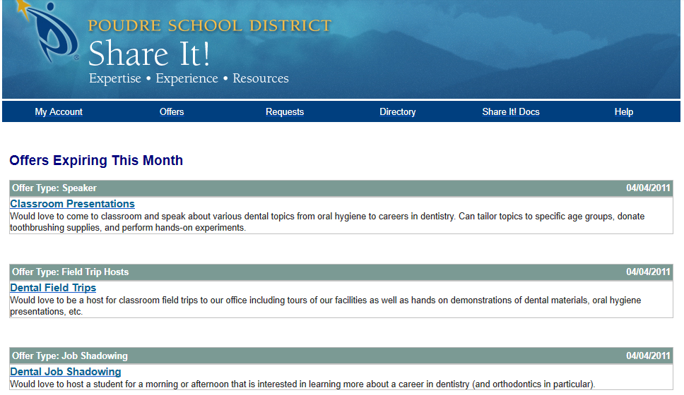
Notify Partners & Staff
Allow partners and staff to subscribe to newsletters
Select recent or expiring offers or requests to publish
Use predefined HTML templates for newsletters

Slide 21
Thank you
K12 Community Engagement Solutions
Mark S. Franke | Relatrix Corporation | mfranke@relatrix.com | 800.570.6234

