Slide 1
Matching School Needs and Partner Resources
Staff Introductory Training

Slide 2
Topics
EZPartner Overview
Set Up A School Staff Account
Create School Requests
Match & Record Outcomes For Your Requests
View & Record Outcomes For Matched Offers
Update Account Settings

Slide 3
Connect Business With Your Schools
Community Partner
Offers
School Staff
Partners apply and then register with the district
Partners appear on the directory listing
Partners can create offers and respond to requests
Employees can register and connect with their employer
Requests
Staff register and select their school
Staff sign-in and create requests
Staff record outcomes of their requests
Staff search for partner offers

Slide 4
EZPartner Users
School Staff
* Register individually
* Affiliate w. their school
* Post needs/requests
* Reply to offers/resources
Community Organizations & Employees
* Register individually
* Affiliate w. their partner profile
* Post offers/resources
* Reply to needs/requests
District EZPartner Administrators
* Recruit & register community organizations
* Administer Partner Directory & Profiles
* Facilitate w. communications & reporting

Slide 5
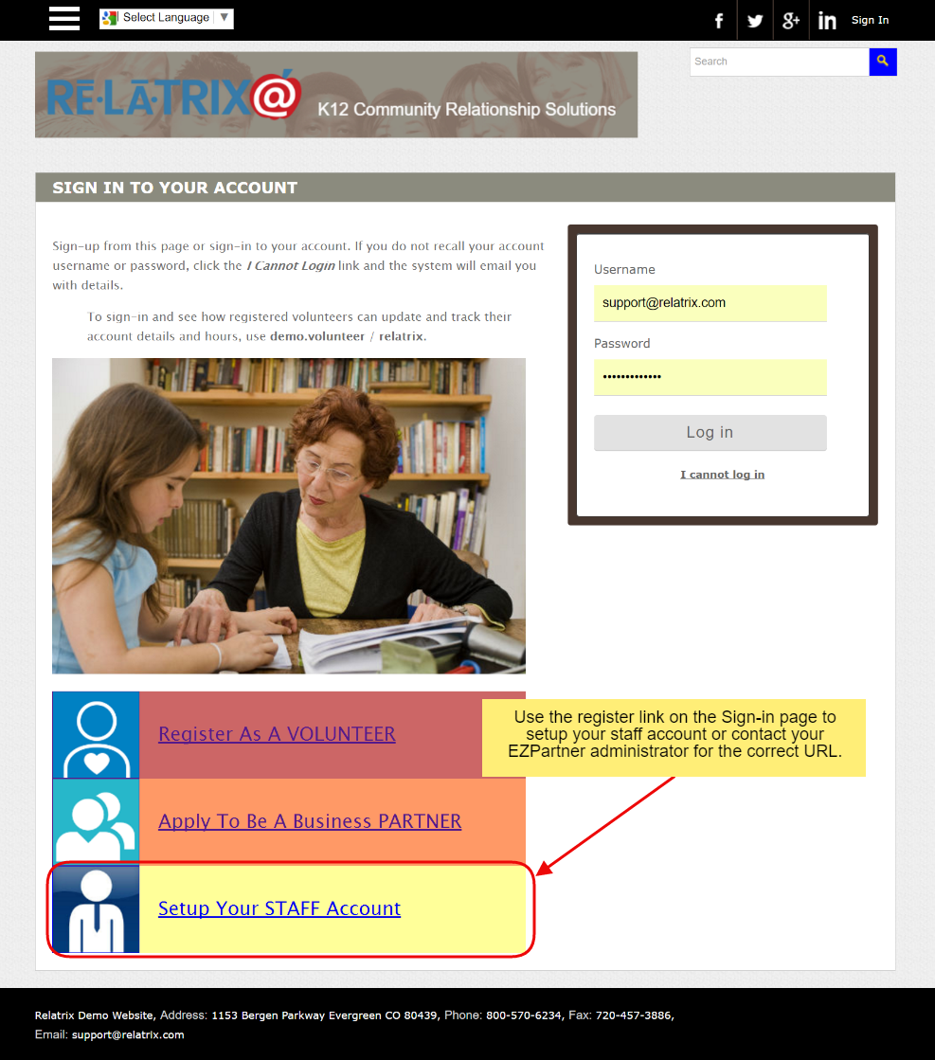
Set Up A Staff Account
Returning Staff can Sign-in with Username & Password
New Staff Account setup starts here or from the URL provided by your EZPartner administrator

Slide 6
Account Credentials
Username can be district email or any other 8+ character text field that includes letters and numbers
Password should be 8+ characters

Slide 7
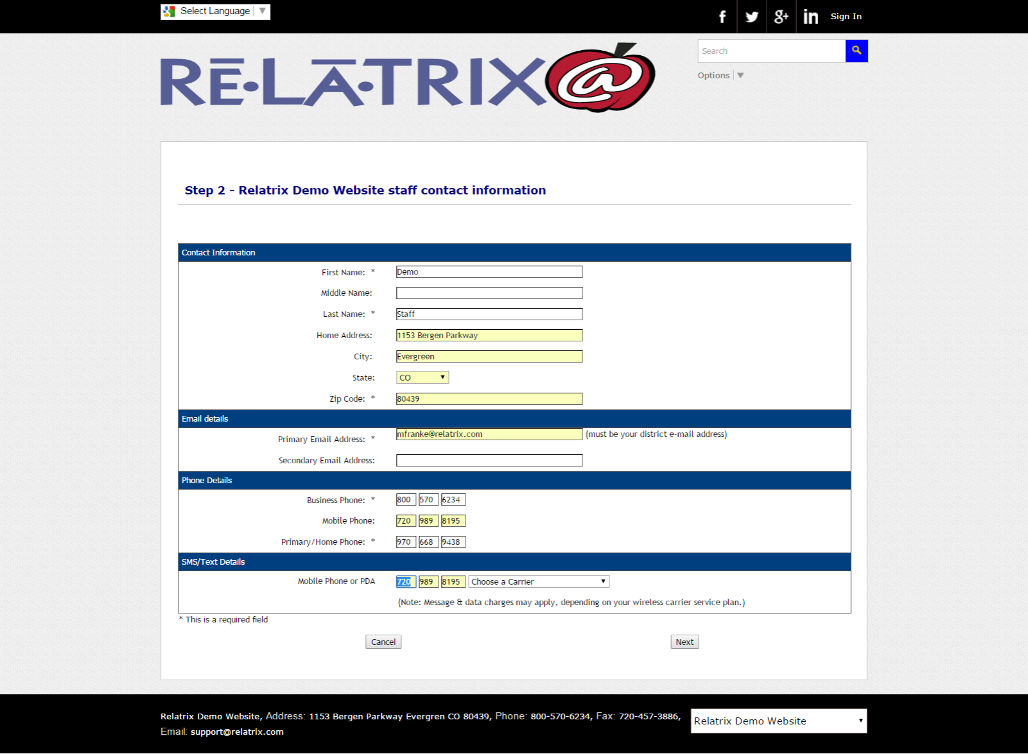
Add Contact Details
Contact details include name, work or home address, email addresses and phone numbers for contact by partners when you create requests
Email address must be your district work email to register as district staff

Slide 8
Select Your School
Select the school or department where you work.
This will auto-assign to all your requests.
Only one school or department can be selected per staff account.

Slide 9
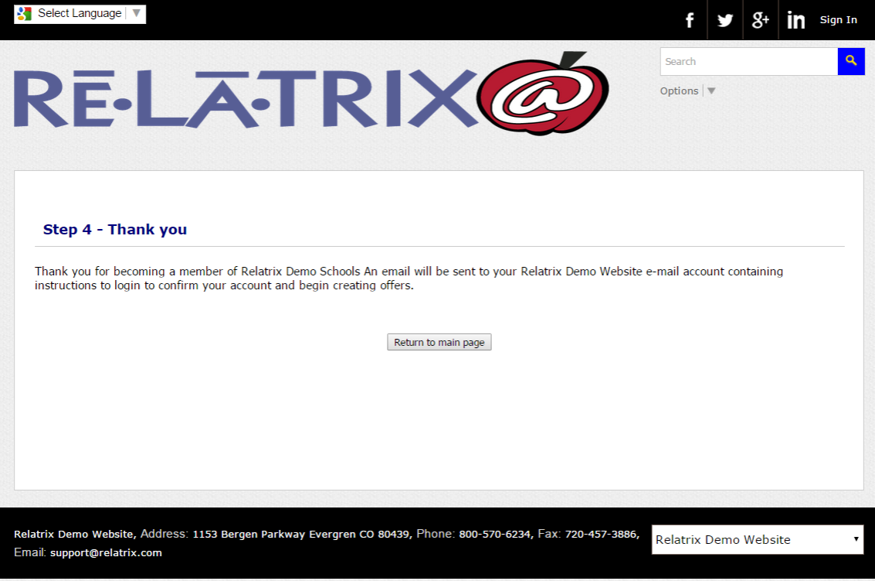
Activate Account
Final Step
After sign up is complete an account activation email is sent to your work email.
Must complete the process by clicking the link in the email.

Slide 10
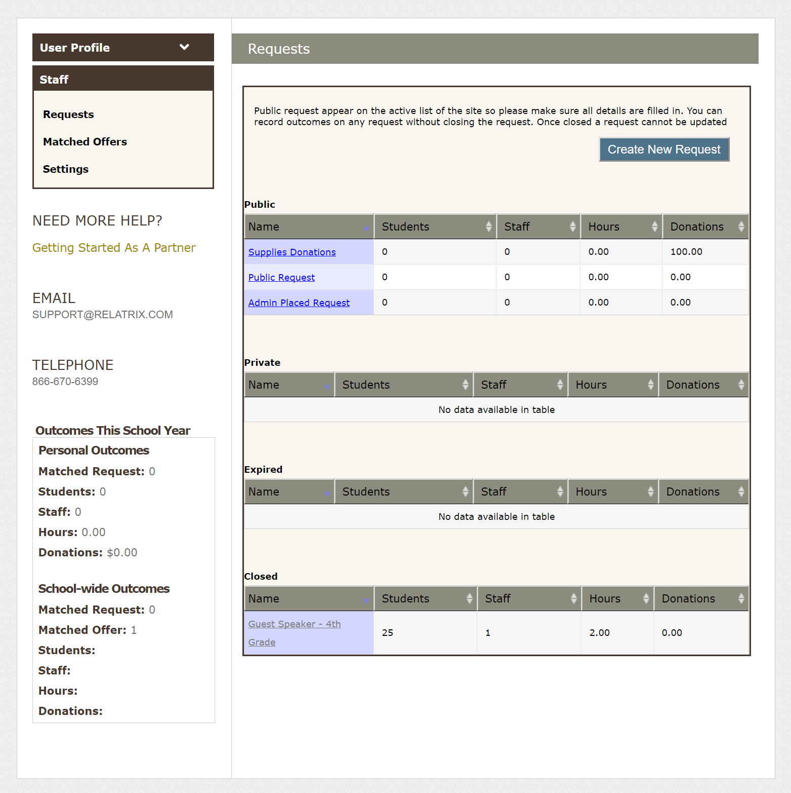
My Account & Requests
User Profile Tab:
Update Contact Details including email and phone
Staff Tab:
Create, update, record outcomes and close requests
View and update matched offers from partners
Update settings including notification of new offer postings

Slide 11
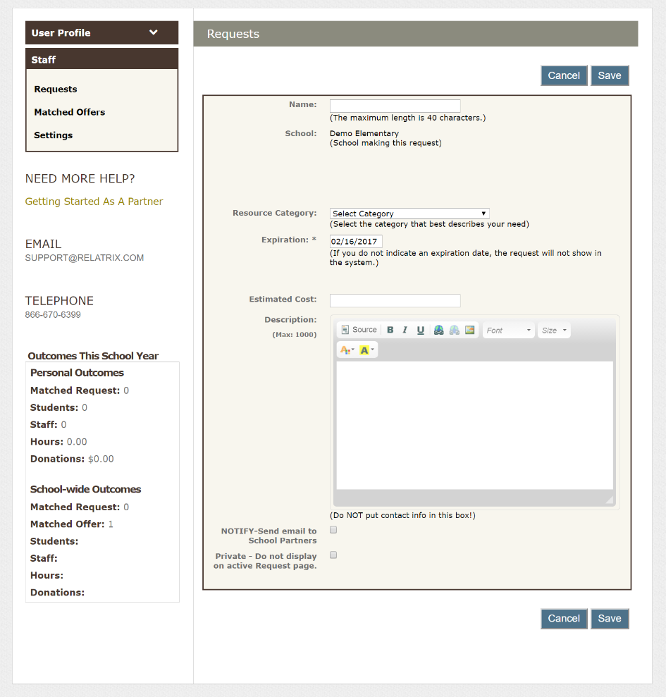
Adding Requests
Name should be self-explanatory, but does not need to include school name
Resource Category defines the type of resource need
Expiration sets date of event or program deadline
Requests disappear from active list on Expiration date
You can send direct notification to school partners & keep request private

Slide 12
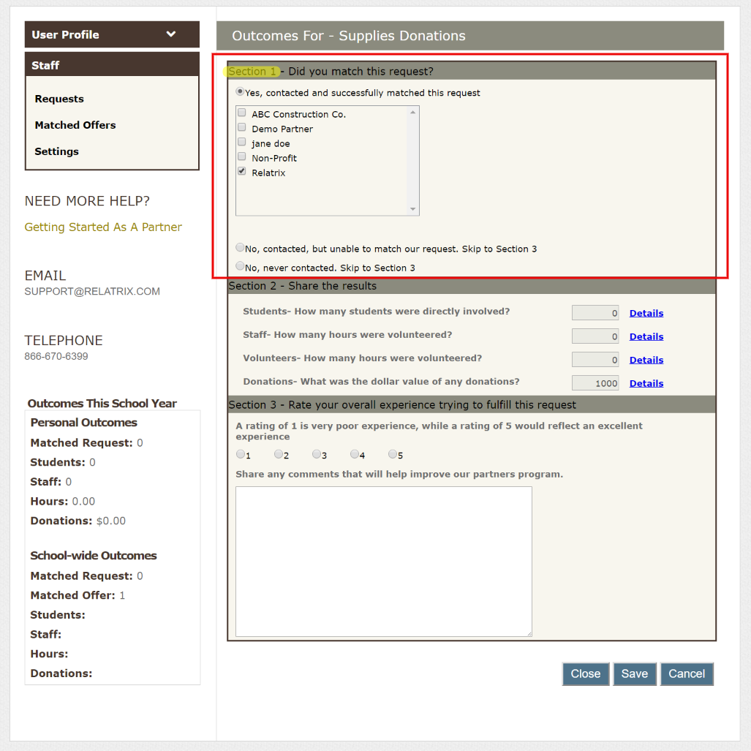
Matching Requests
From Request list choose a request by name and then Outcomes button
In Section 1 of Outcomes page choose (match) the partner(s) that you are working with on this request
You can add more partners anytime until you CLOSE the request
Matched Partners can view outcomes for a request on their account under Matched Requests

Slide 13
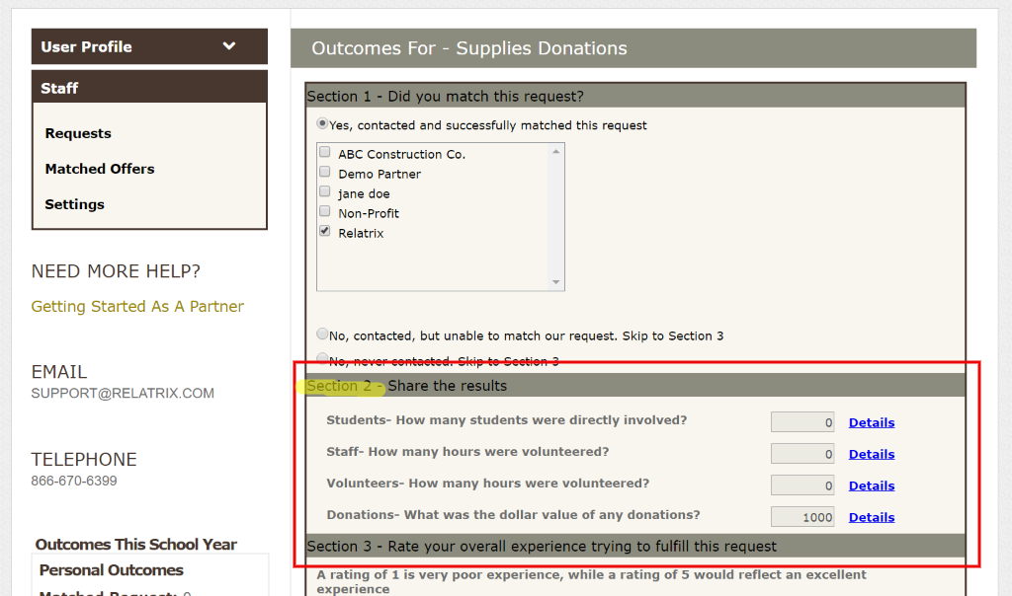
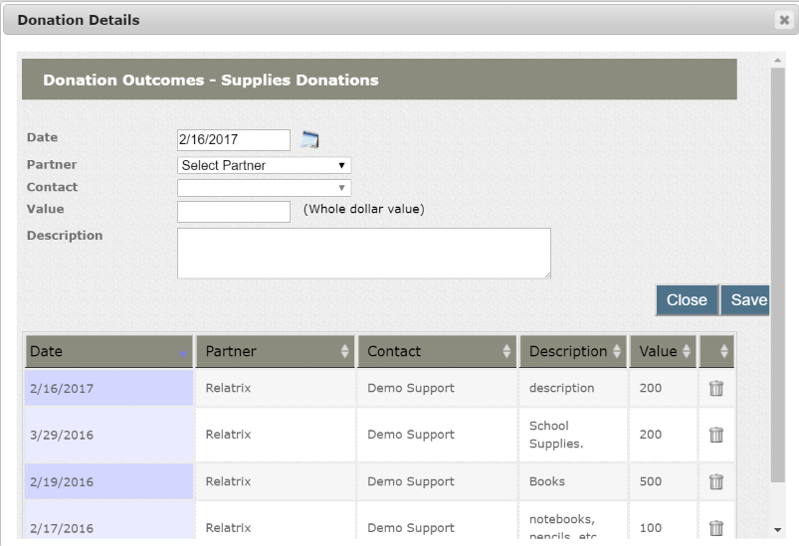
Record Request Outcomes
Click Details for the Outcome type you want to record. This will pop-up a window
Specify a date for the Outcome and choose the partner (must be matched) who provided the resource
Input other details and press Save
Press Close on the Details page to return to the Request Outcomes page.

Slide 14
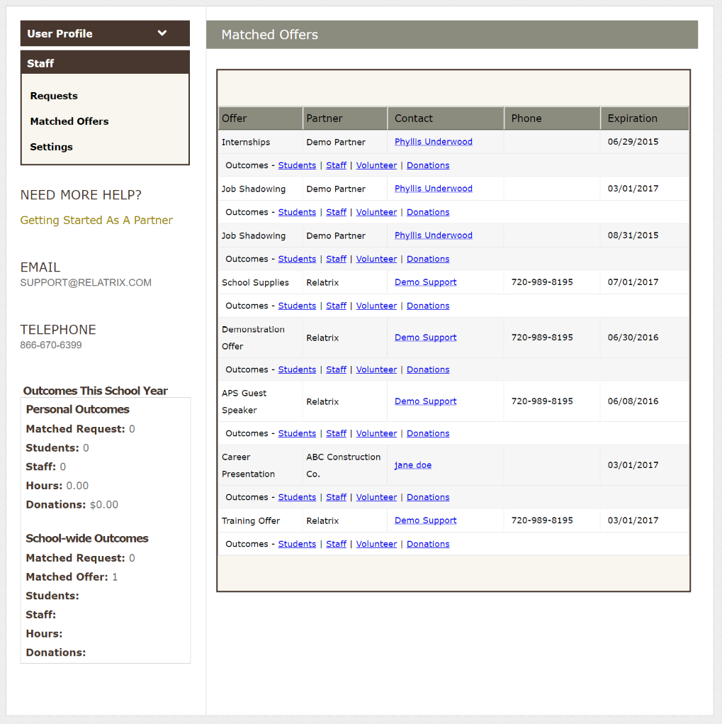
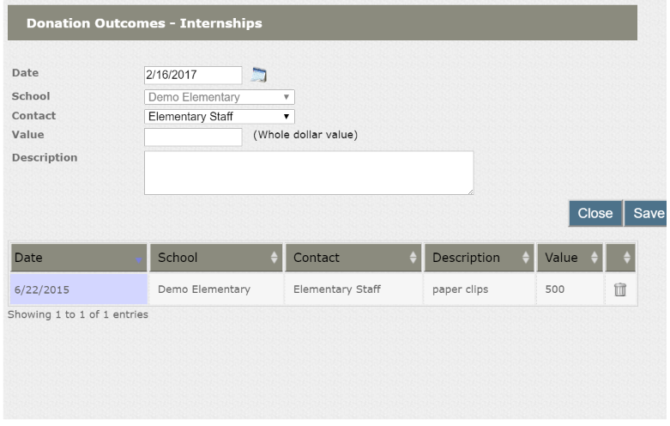
Matched Offers
Click Matched Offers sub-tab to view list of offers any partners are working on with your school
Email the partner contact with questions
Click on any Outcome type to view currently recorded outcome details and edit/add outcomes

Slide 15
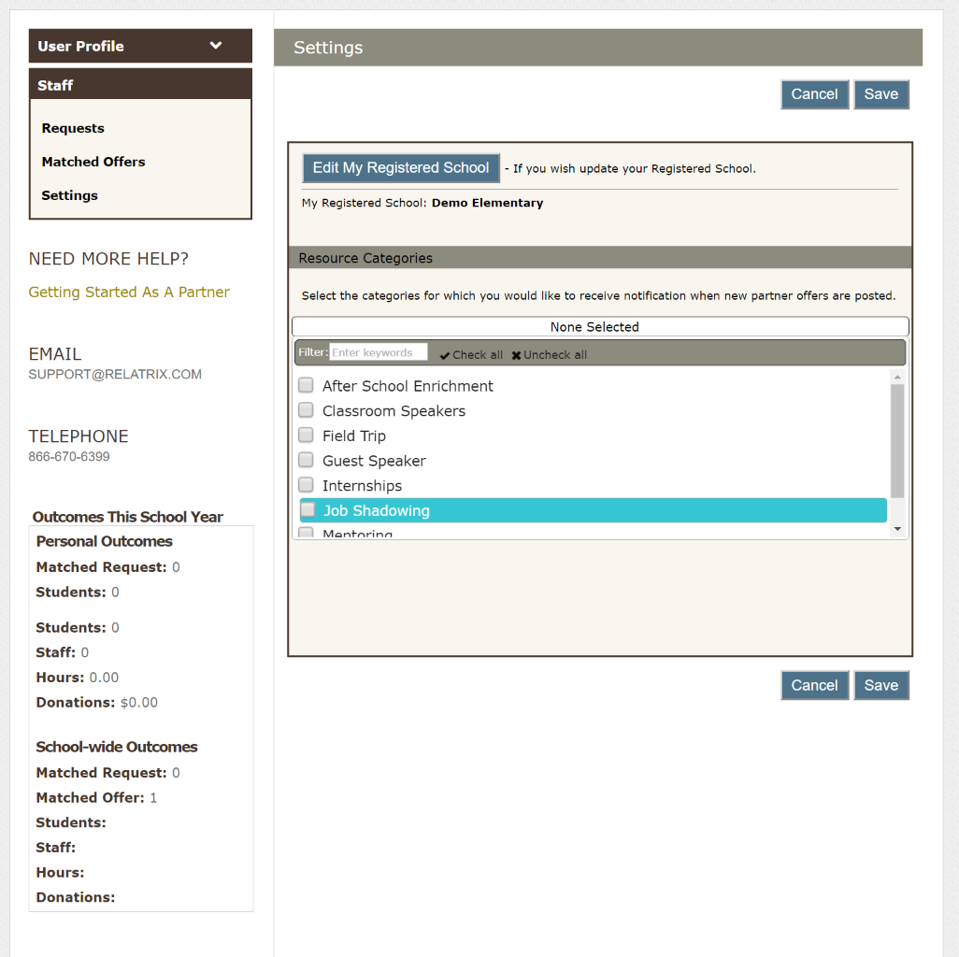
Account Settings
Edit registered school location if you change campuses.
(Close out active requests or ask EZPartner admin to assign them to another Staff member at your school)
Select resource categories to receive notifications when any new offers are posted by partners

Slide 16
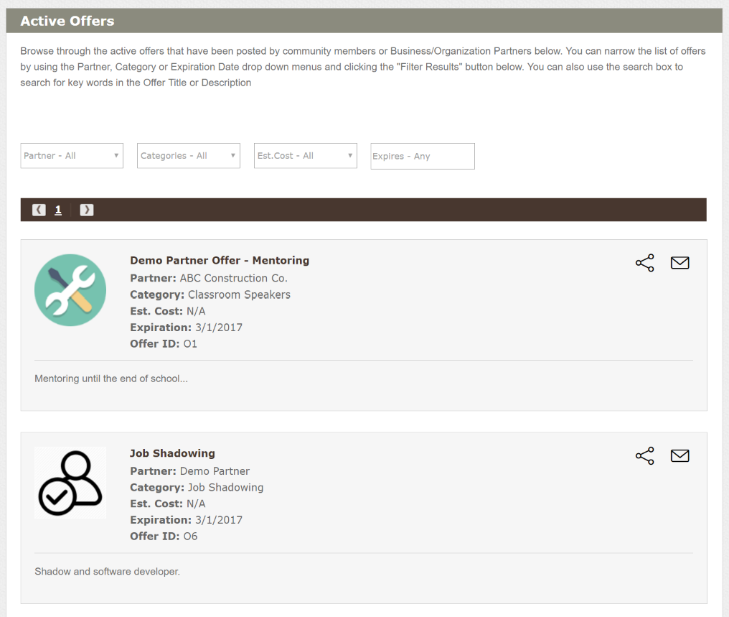
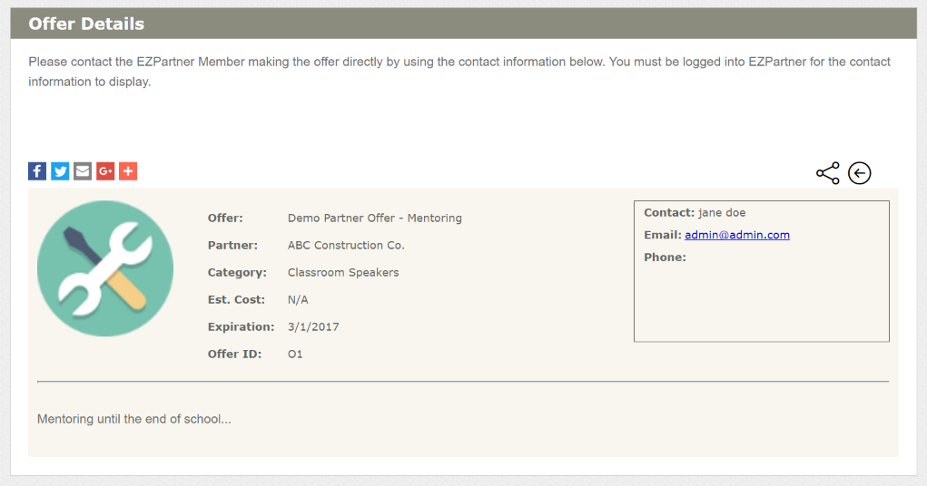
Search For Offers
Search for offers using Search box on Active Offers List page
Filter offers by partner, category or expiration or estimated cost
Click the Contact icon (Envelope) to view Request and Contact details
Contact Offer originator by email or phone
Share details of Offer to social media account or by email

Slide 17
Frequently Asked Questions
How do my partners get registered in the system?
Partners can apply and register online or they can be added by an administrator. During registration a Partner can choose your school as one they work with most closely.
Can I register my partners on their behalf?
Yes. Ask your district Partners In Education office/coordinator for the URL to access the partner registration form. You will be setting up the partners account and profile.
How do partners get assigned to my school?
Partners can either select your school as part of registering and setting up their partner profile, or through their account settings after completing their registration and activating their account.
Can I send a request directly to my school partner(s)?
When you create a request you have the option to notify school partners. This option lets you select which partner contacts to notify. You can also choose to make the request PRIVATE.
What if I am working with more than one partner on a request?
At any time you can match a partner to your request, whether they are a school partner or not. Matching the Partner lets you record outcomes and them view the outcomes..
I accidentally CLOSED a request. What can I do?
Contact your district Partners In Education office/coordinator and let them know the name and ID of your request. They can re-open the request so you can continue working with it.

Slide 18
Thank you
Customer Support & Training Team
866.670.6399
support@relatrix.com
Twitter: @relatrix_help

